Slide 1
This is a hidden slide
Dear honorable teacher please follow the instructions that has given in the slide notes (under the every slide). It would be helpful to take a successful class. Thanks a lot. I wish you good luck.

Slide 2

Welcome

Slide 3


Presented by
SK. MD. HARUNAR RASHID
Senior Assit: Teacher
Sonatola Model High School.
Sonatola, Bogra. 01714622498.
Lesson:
ENGLISH FOR TODAY, CLASS: 6, UNIT: 15.

Slide 4
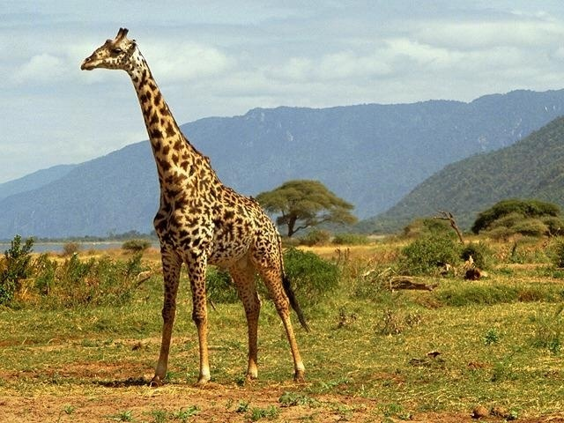
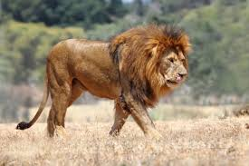
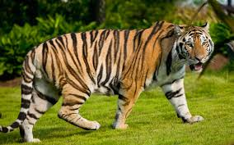
LOOK AT THE PICTURES
Lion - mane
Tiger - black and yellow stripes
Giraffe -Tall and printed body
Do you know these animals. What is their name and identifying marks ?
Notes:
Teacher will show the picture for eliciting the answer if they fail then T. will give feedback.

Slide 5
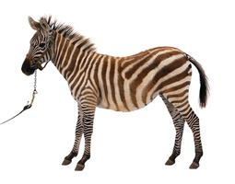
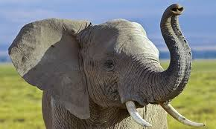
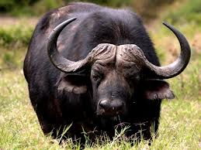
LOOK AT THE PICTURES
Elephant - trunk
Buffalo - long horns
Zebra - black and white stripes
Do you know these animals. What is their name and identifying marks ?
Notes:
Teacher will show the picture for eliciting the answer if they fail then T. will give feedback.

Slide 6
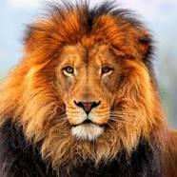
Lesson Declaration
So Today we`ll discuss about
The Lion`s Mane

Slide 7
Learning outcomes
After completing this lesson students will be able to
read and understand texts through silent reading.
infer meaning from context
Listen for information.
ask and answer questions
Write answers to questions.

Slide 8
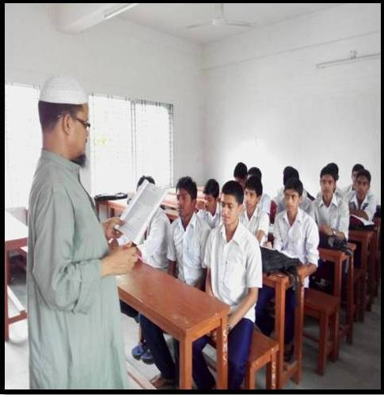
Presentation
First listen to me attentively then answer the following questions.
Where was the lion sitting?
What did lion see into the river?
What do you think is the lesson of the story?
Notes:
Teacher will read the text loudly giving proper attention to pronunciation, pause and intonation.

Slide 9
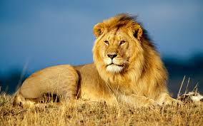
Let`s enjoy a video clip
Click here
Notes:
Teacher can discuss the power and position of lion. Why he is the king of beast.

Slide 10
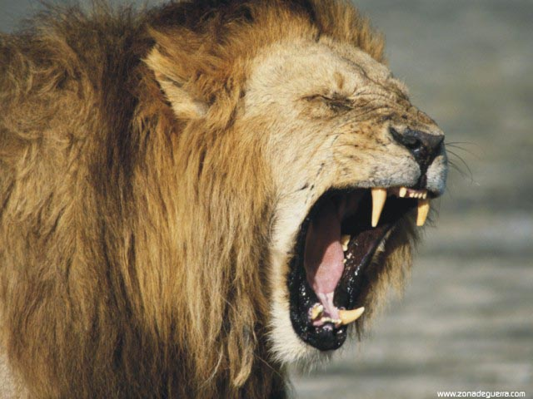
Zebra`s suggestion
“Flap it all up. That will suit you!” the Zebra said.
Notes:
Teacher will show the picture for eliciting the answer if they fail then T. will give feedback.

Slide 11
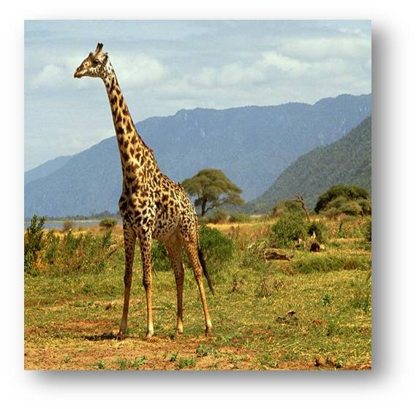
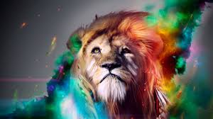
Giraffe`s suggestion
“Yes, it will even look better with a bit of colour to match your moustache,” the Giraffe added.
Notes:
Teacher will show the picture for eliciting the answer if they fail then T. will give feedback.

Slide 12
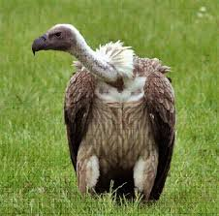
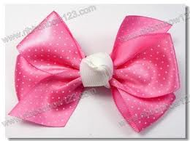

Vulture`s suggestion
“What about a few ribbons ?” the vulture asked.
Notes:
Teacher will show the picture for eliciting the answer if they fail then T. will give feedback.

Slide 13
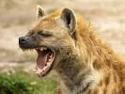

Hyena`s suggestion
Then cried the Hyena, “ I know a paper crown is what you need!”
Notes:
Teacher will show the picture for eliciting the answer if they fail then T. will give feedback.

Slide 14
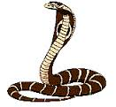
Snake`s remark
“If a king is a wise king, nobody cares about his hairstyle”
Notes:
Teacher will show the picture for eliciting the answer if they fail then T. will give feedback.

Slide 15

Mane
Key word
The lion thought that his mane was too old.
Meaning
(Click here)
Long hair on the neck of a horse or a lion.
Notes:
First, the phrase can be shown. The SS can be asked to pronounce the phrase. If it is needed teacher can help. Then the picture can be shown and asked to guess the meaning. For feedback click on meaning button.

Slide 16
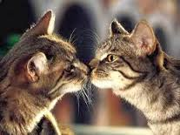
Reflection
Key word
The cat is seeing his reflection on the mirror.
Meaning
(Click here)
Mirror image
Notes:
First, the phrase can be shown. The SS can be asked to pronounce the phrase. If it is needed teacher can help. Then the picture can be shown and asked to guess the meaning. For feedback click on meaning button.

Slide 17
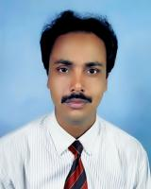
Moustache
Key word
Mr. Nurul Islam`s moustache is very nice.
Meaning
(Click here)
A line of hair that some people have on their upper lip
Notes:
First, the phrase can be shown. The SS can be asked to pronounce the phrase. If it is needed teacher can help. Then the picture can be shown and asked to guess the meaning. For feedback click on meaning button.

Slide 18
Raise
Key word
Seeing the king the snake raised his head.
Meaning
(Click here)
Lift or move upwards.
Notes:
First, the phrase can be shown. The SS can be asked to pronounce the phrase. If it is needed teacher can help. Then the picture can be shown and asked to guess the meaning. For feedback click on meaning button.

Slide 19

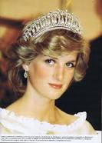
Crown
Key word
A king or queen is needed a royal crown.
Meaning
(Click here)
A cap of king’s or queen’s
Notes:
First, the phrase can be shown. The SS can be asked to pronounce the phrase. If it is needed teacher can help. Then the picture can be shown and asked to guess the meaning. For feedback click on meaning button.

Slide 20
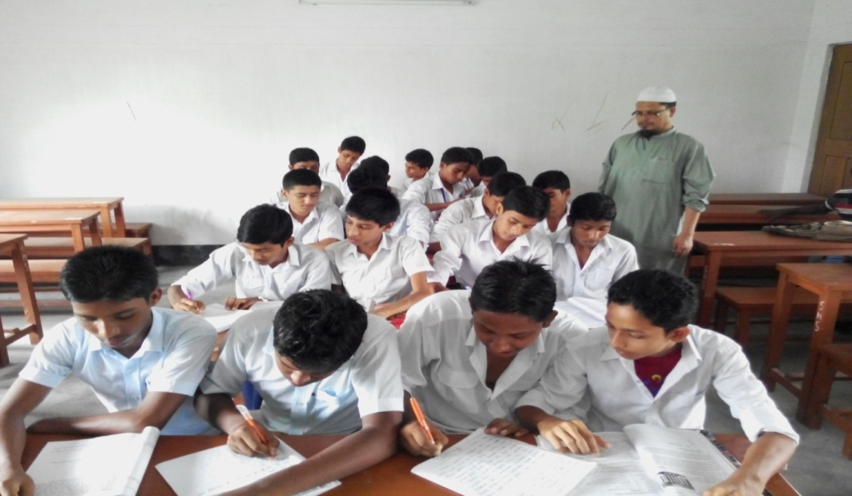
Individual Work
Read the text silently then go to section – A1 and match the words in Column A with the meanings given in the column B.
Notes:
Teacher will monitor the class.

Slide 21
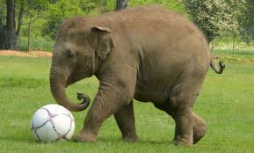
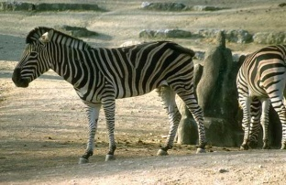

Pair works
Every animal has something that makes it different from others. Now match the picture in column A with the words in column B to know the identifying marks of some animals.
Column A | Column B | Animals
 | wool
 | Stripes
 | mane
 | Trunk
Notes:
Teacher will show the picture for eliciting the answer if they fail then T. will give feedback.

Slide 22
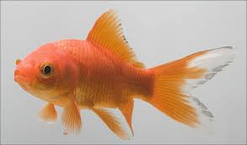
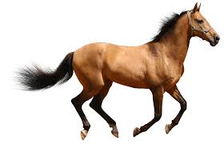
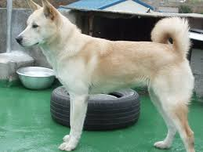
Pair works
Every animal has something that makes it different from others. Now match the picture in column A with the words in column B to know the identifying marks of some animals.
Column – A | Column – B | Column - C
 | Pony tail
 | Curved tail
 | Scale
 | Horns
Notes:
Teacher will show the picture for eliciting the answer if they fail then T. will give feedback.

Slide 23
Group works
Read the text again and fill in the blanks with the words from the box.
cried
paper
ribbons
look
king
opinion
unhappy
new
lived
flap
like
passing
Once upon a time, there (a) ------------- a lion. He was the (b) ----------- on the jungle. But he was (c) -------------- with his life. He wanted a (d) -------------- hairstyle. So the Zebra said to (e) ------------ his mane. And the Giraffe thought it would (f) ------------ better if he added a bit of colour. Then the vulture asked about (g) --------------. The Hyena suggested to have a (h) -------------- crown. But when the lion saw a snake (i) -------------- by silently, he wanted to know his (j) -------------
Notes:
After silent reading, student will be asked to fill in the gaps. Teacher will try to elicit the answer from students if they fail, teacher will give feedback y click.

Slide 24
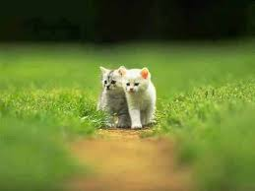


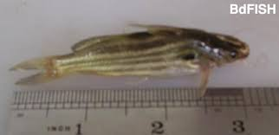
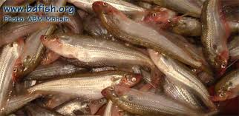
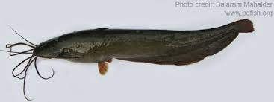
Here is a puzzle for you
Can you say which baby is born with a moustache?
Cat
Lion
Tiger
and some fishes baby also born with a moustache
Notes:
Teacher will show the picture for eliciting the answer if they fail then T. will give feedback.

Slide 25

HOME WORK
What is the moral of this story ?

Slide 26
THE END

